Slide 1
Sales and Profit ANALYSIS
Dashboard using powerbi

Slide 2
Overview
A Sales and Profit project in Power BI can involve creating dashboards and reports to visualize sales performance and profitability, providing insights into key metrics and trends. This can include analyzing sales by region, product, time, or customer segment, as well as calculating and displaying profit margins and profitability.
To contribute to the success of a business by Utilizing data analysis techniques, specifically focusing On Time series analysis, to provide valuable insights and accurate sales forecasting.

Slide 3
Objectives:
Sales and profit objectives in Power BI projects typically focus on analyzing and visualizing data to drive business decisions. Here are some common objectives:
Total Sales Analysis: Calculate and display the total sales value for specific periods to understand revenue trends.
Profit Calculation: Visualize profit margins and total profit achieved to assess financial performance.
Year-over-Year Comparisons: Compare sales and profit performance across different timeframes, such as months or years.
Customer Insights: Analyze sales by customer to identify top-performing segments and opportunities for targeted marketing.
Product Performance: Evaluate sales and profit by product to determine which items contribute most to revenue.

Slide 4
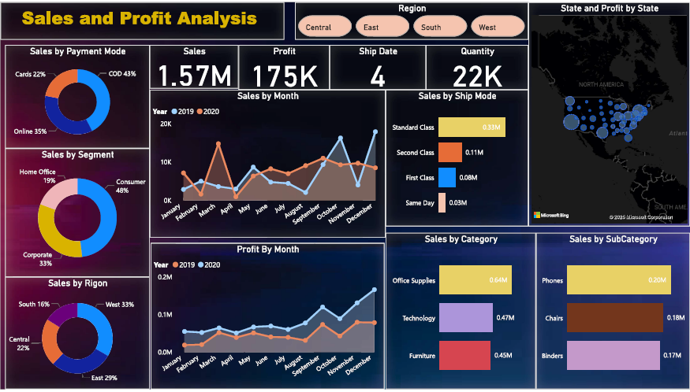

Slide 5


Slide 6
DAX FORMULAS
Average_Delivery = DATEDIFF('SuperStore_Sales_Dataset'[Order Date],'SuperStore_Sales_Dataset'[Ship Date],DAY)
SalesForcast=SUMMARIZE('SuperStore_Sales_Dataset',SuperStore_Sales_Dataset[Order Date],"total_sales",SUM(SuperStore_Sales_Dataset[Sales]))

Slide 7
CONCLUSION
The conclusion of a sales and profit analysis project in Power BI typically highlights the actionable insights derived from the data.
Enhanced Decision-Making: The project provides a clear understanding of sales trends, profit margins, and customer behavior, enabling data-driven decisions.
Operational Efficiency: By identifying top-performing products, regions, or customer segments, businesses can optimize their strategies and resource allocation.
Financial Insights: The analysis of profit margins and revenue trends helps in setting realistic financial goals and improving profitability.
Interactive Reporting: The Power BI dashboards offer dynamic and user-friendly visualizations, making it easier for stakeholders to explore and interpret data.

